Slide 1
Airline Safety
Brett Sutow

Slide 2
Key Points
Air travel is still the safest form of travel
Highlight the comparison between car and plane
Demonstrate the various airlines that have had issues
Show the decreases over time

Slide 3
Airline Fatalities, Incidents, Accidents
The first graph will compare airplane fatalities to incidents and accidents
This graph shows the relative safety of air travel as incidents and accidents are low
It also shows the number of fatalities in the past 30 years

Slide 4
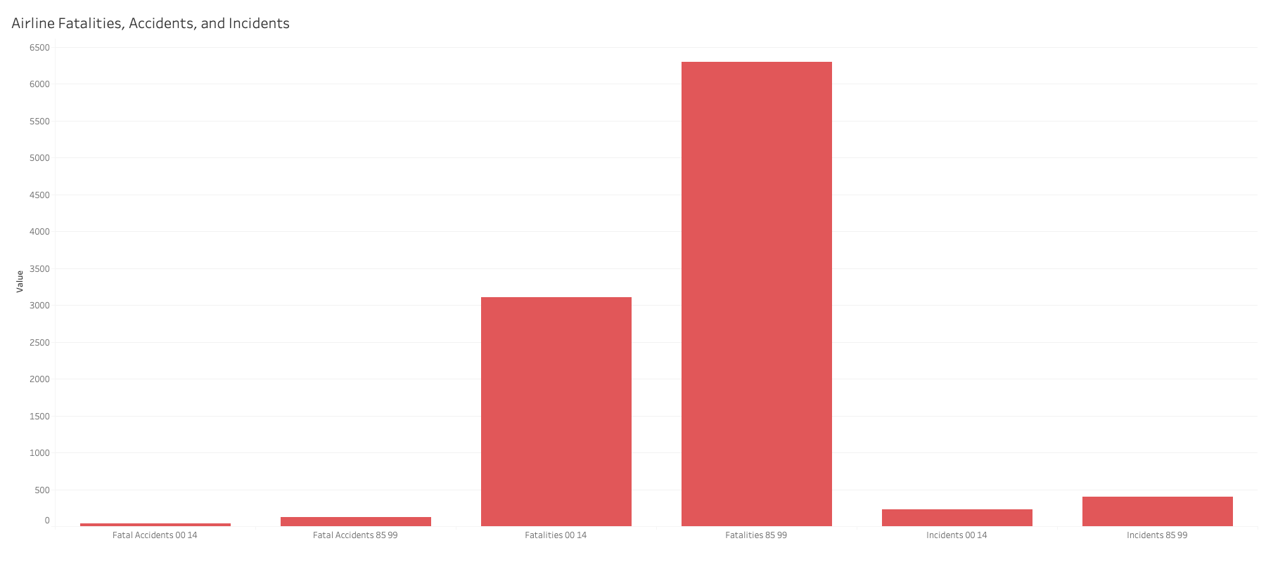

Slide 5
Fatalities Over Years
The following graphs show various year spans showing airline deaths
These deaths are broken into two different periods
It also highlights the various airlines they have occurred
Showing that airlines overall are safe based off consistency across the board of low deaths

Slide 6
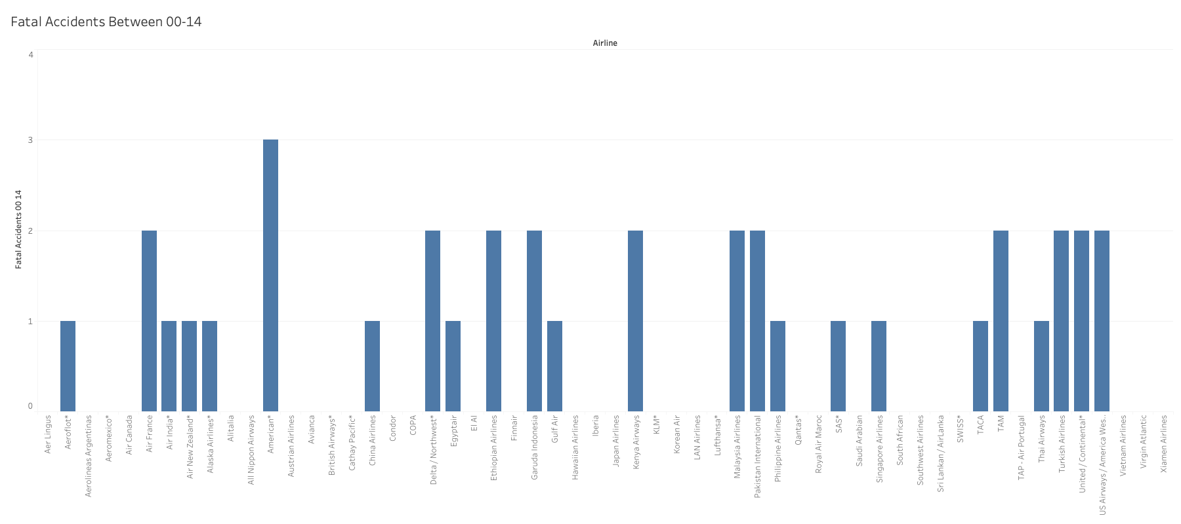

Slide 7
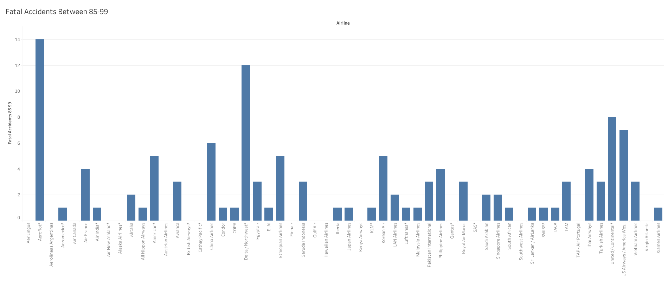

Slide 8
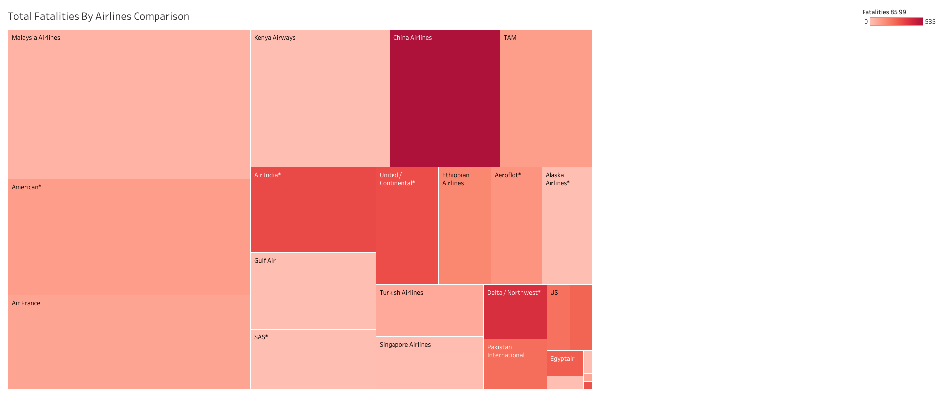

Slide 9
Motor Vehicle Accidents
This data shows the motor vehicle accidents in 2019 alone across the country
This data highlights the fact that there are more motor vehicle crashes than there are airline crashes
It also highlights the fact that in 2019 there were over 74k people impacted by an accident
This also breaks the accidents down by state to provide a better outlook

Slide 10
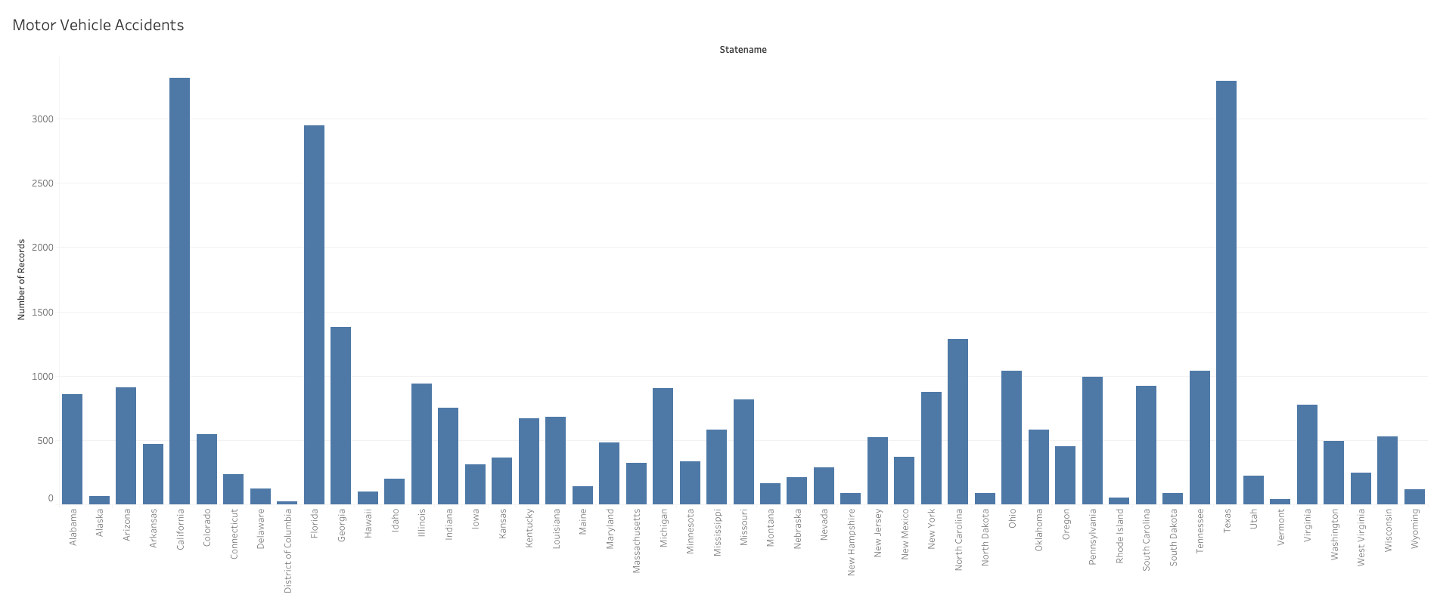

Slide 11
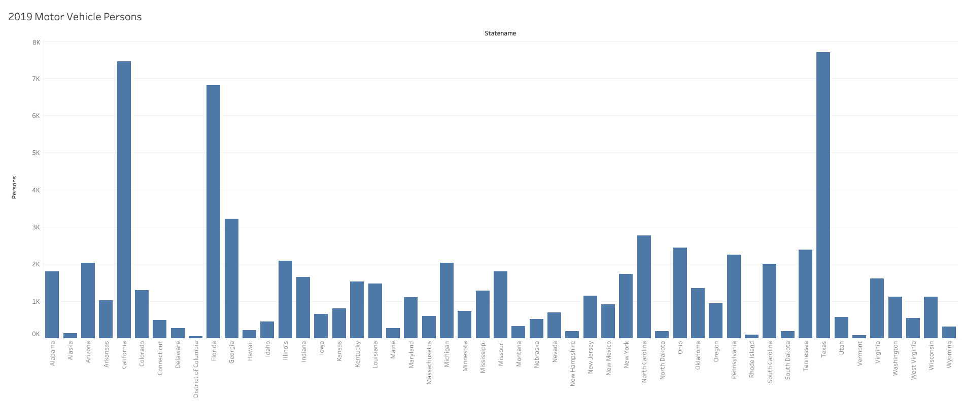

Slide 12
Miles Flown Per Week
The following two graphs again show the two different periods for flights
In this data it highlights the fact that there are billions of miles flown per passenger per week
Which shows the relative safety of flying per mile compared to driving per mile

Slide 13
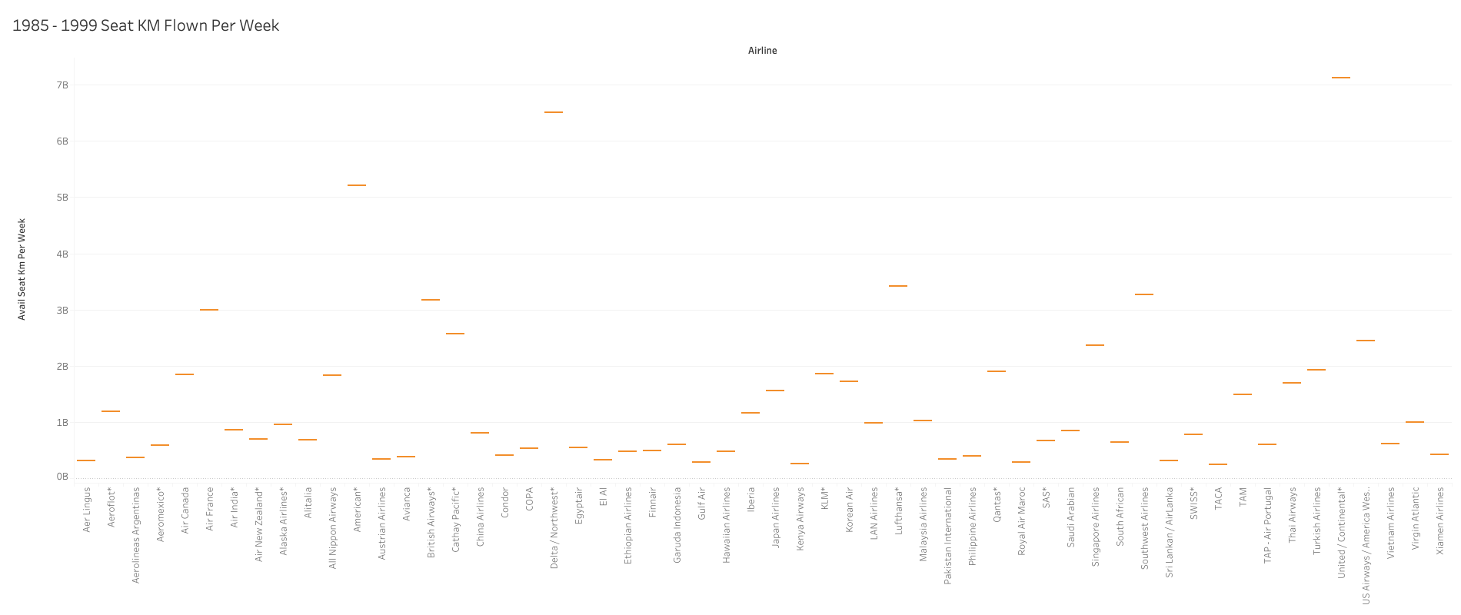

Slide 14
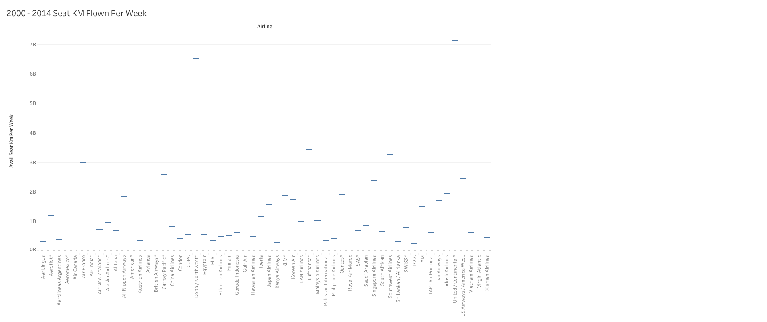

Slide 15
Airline Departures vs Accidents
The following graphs highlight the number of departures, deaths and accidents since 1940
This is to show the fact that as the number of flights have increased and departures have increased accidents and deaths have actually gone down
The graphs show the exponential growth in flight safety over the years
Airline travel has become safer since 1940 whereas car travel still holds more accidents

Slide 16
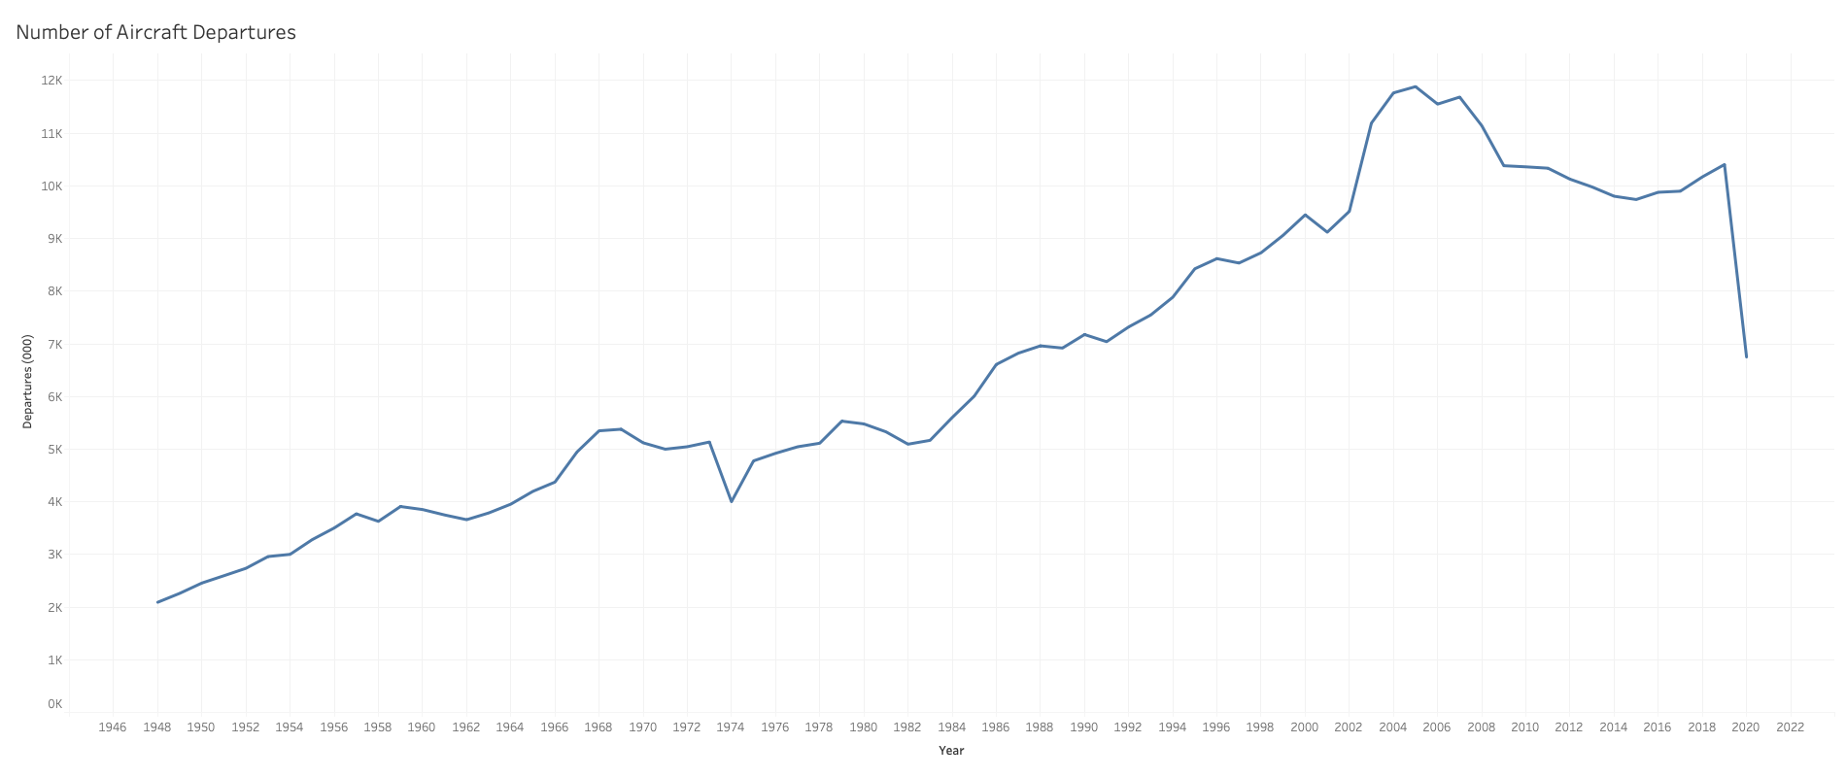

Slide 17
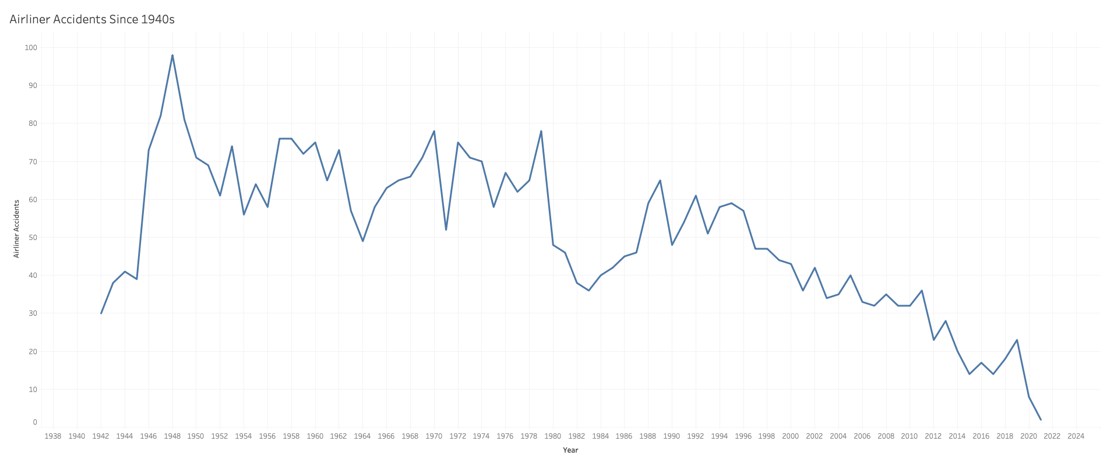

Slide 18
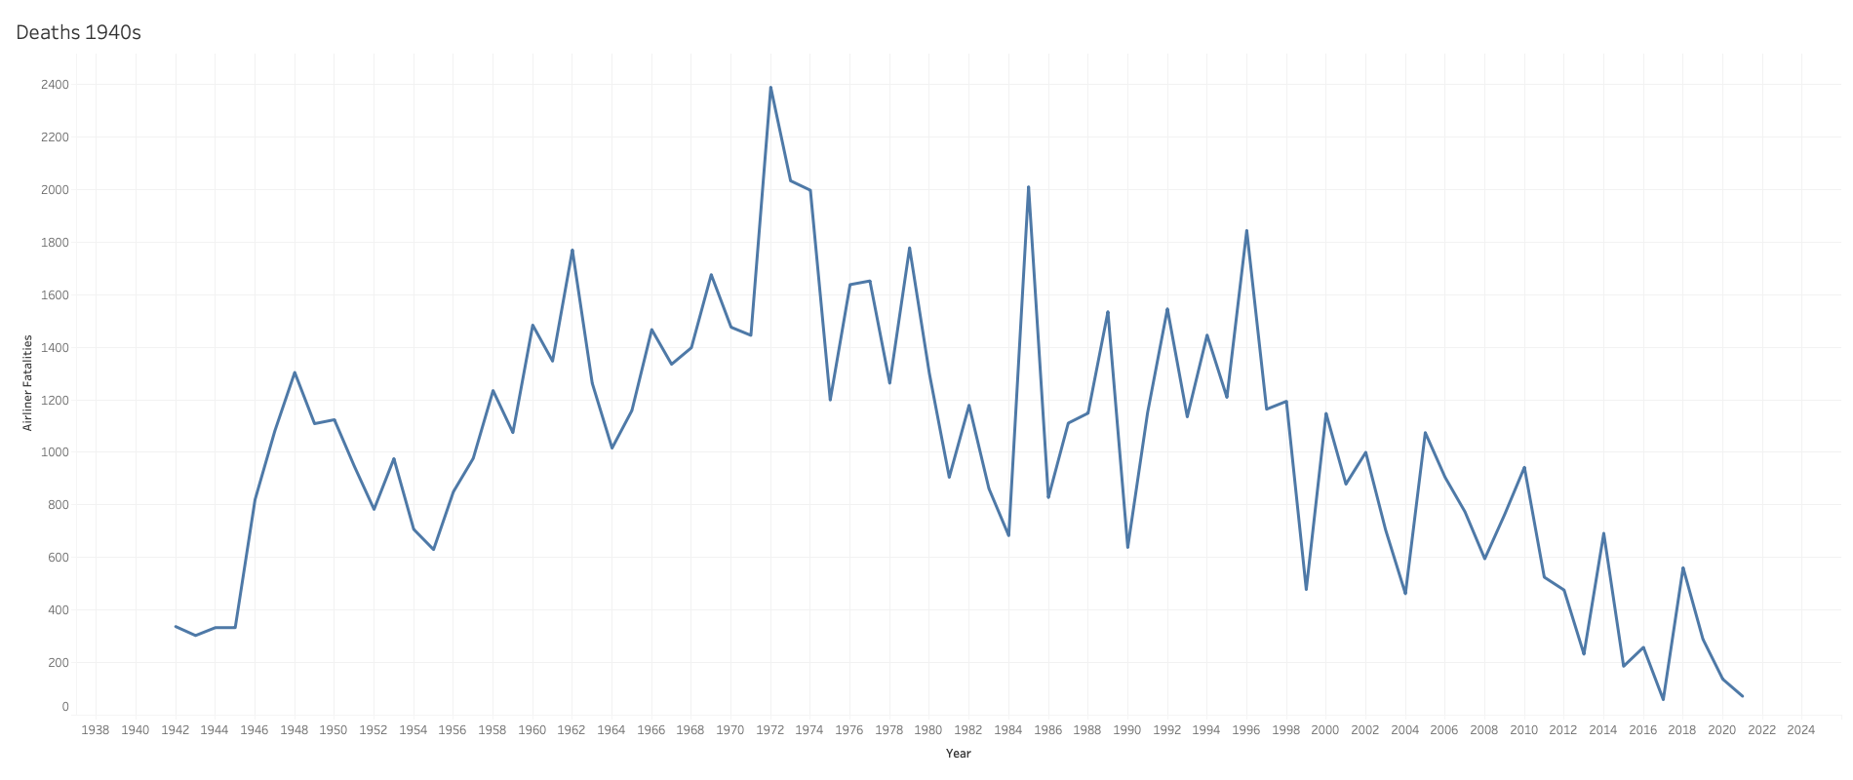

Slide 19
Type of Flight Deaths
This graph shows the flight death totals by type of plane or event
This allows comparison of a passenger plane compared to a private jet
This graph also shows the deaths caused by hijacking which is a rare occurance

Slide 20
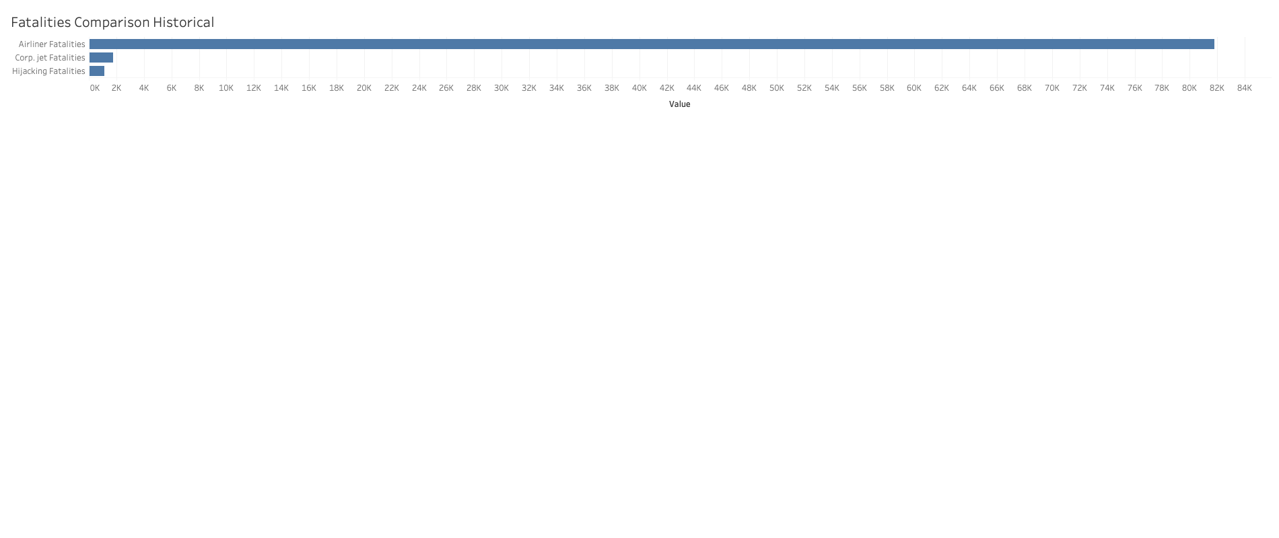

Slide 21
Conclusion
The data speaks volumes for the safety of air travel
As the data points highlighted flights have become safer since 1940
As the number of planes flying has increased the number of accidents has decreased
Car travel still has more accidents and are more likely to occur
Fatality on a plane is relatively low compared to other forms of travel

Slide 22
References
Airlines for America. (n.d.). U.S. Airline Traffic and Capacity. https://www.airlines.org/dataset/annual-results-u-s-airlines-2/#
fivethirtyeight/data. (n.d.). GitHub. https://github.com/fivethirtyeight/data/tree/master/airline-safety
NHTSA. (n.d.). NHTSA. https://one.nhtsa.gov/Data
Ranter, H. (n.d.). Aviation Safety Network > Statistics > By period. Aviation Safety. https://aviation-safety.net/statistics/period/stats.php?cat=A1

